Slide 1

Top YouTube Channel Analysis
Christina Zhang, Olivia Wang, Yanjun Jiang

Slide 2
Roadmap
Web Scraping
Exploratory Data Analysis
Data Preprocessing
Model Building and Training
Website Developing

Slide 3

01.
Web Scraping

Slide 4
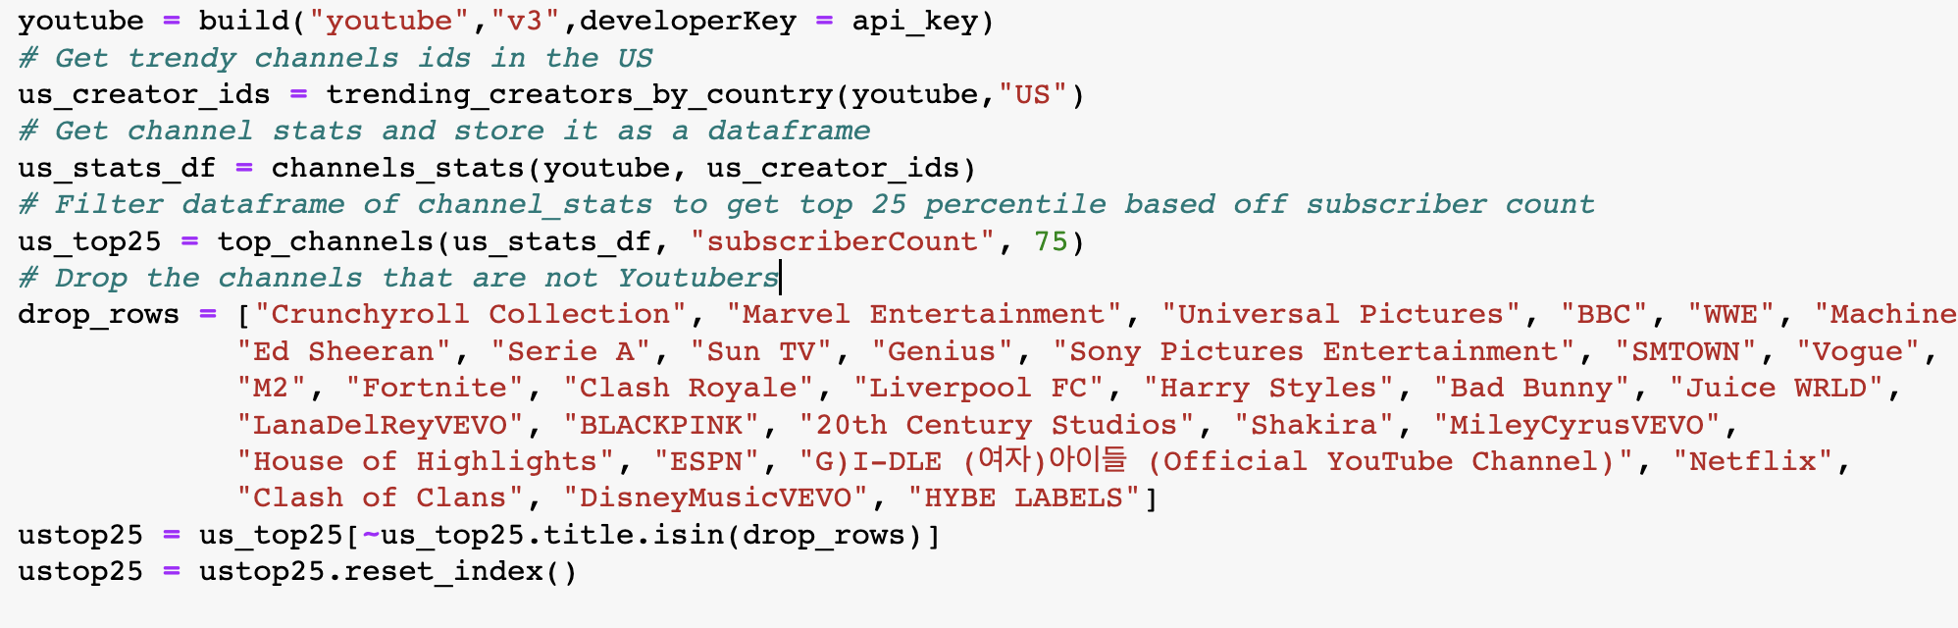
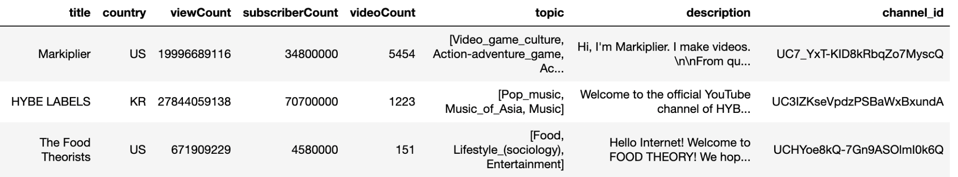
Get Top US Channels Data

Slide 5
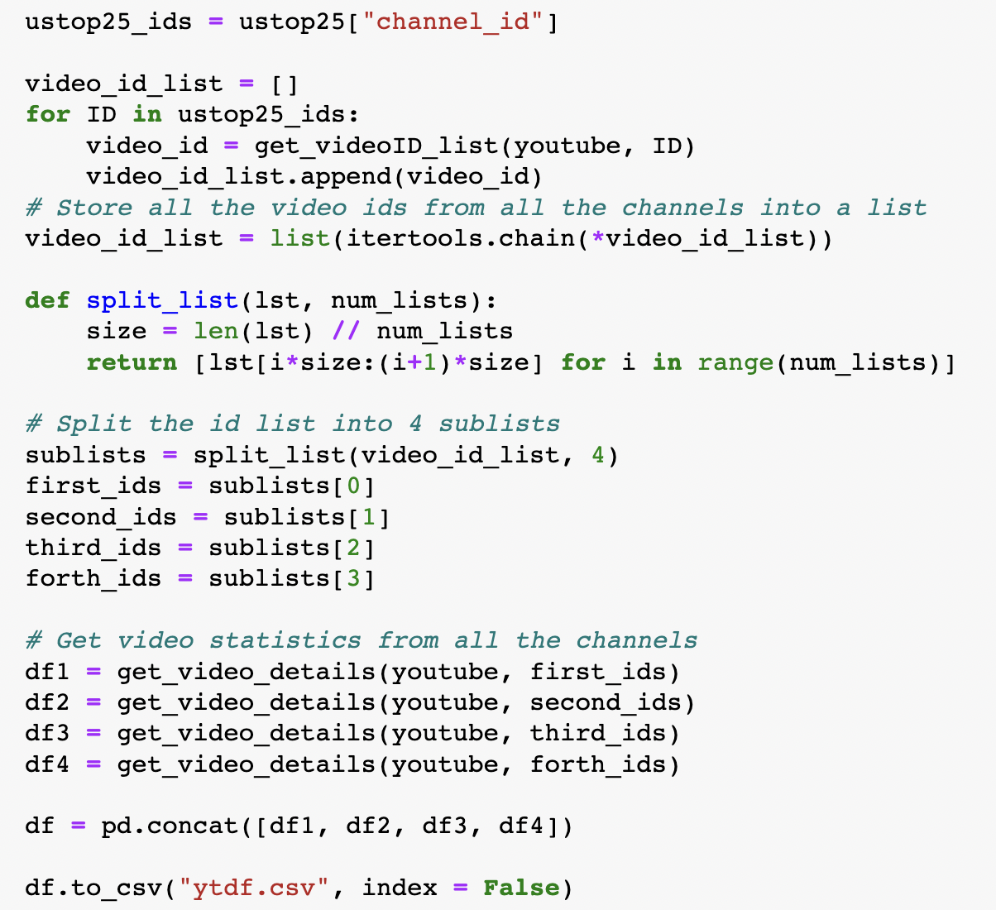
Get Video Data

Slide 6
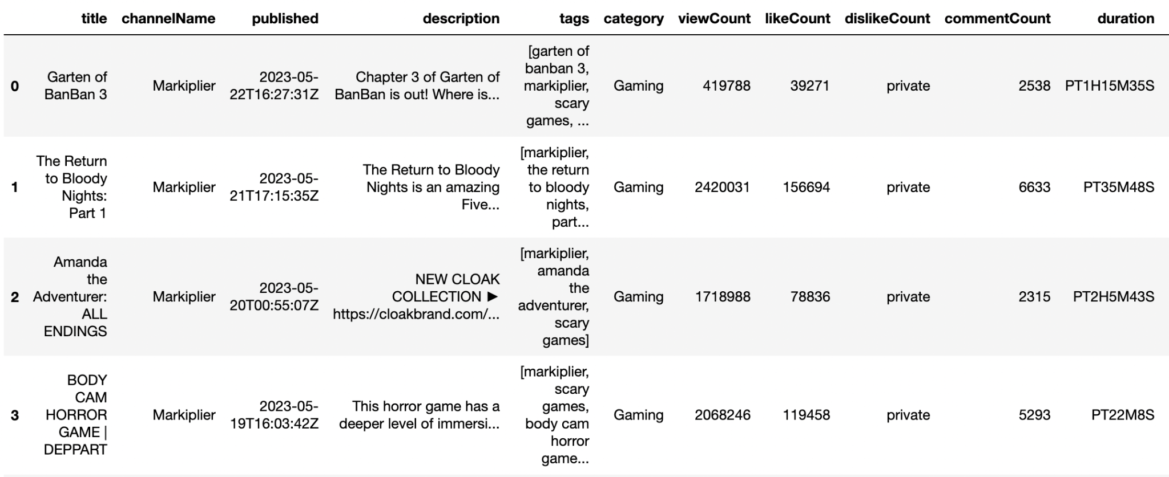
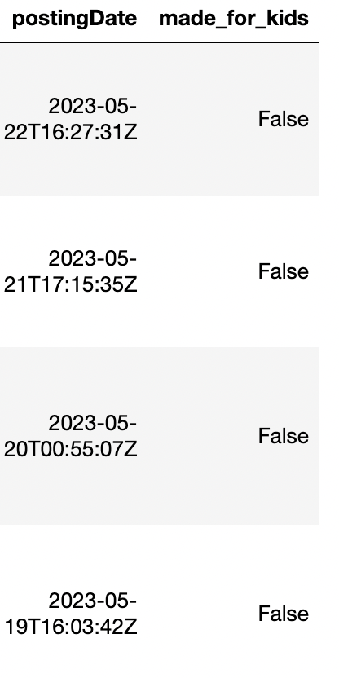
34644 rows, 13 columns

Slide 7

02.
Exploratory Data Analysis

Slide 8
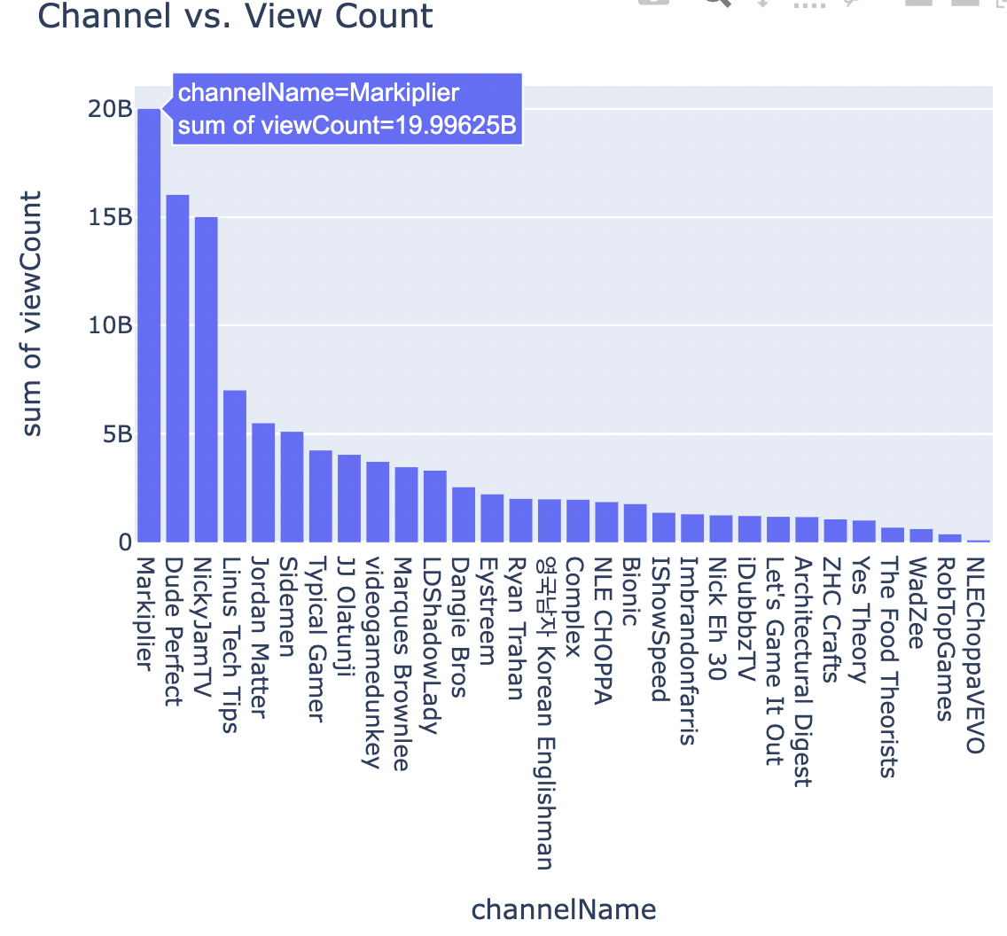
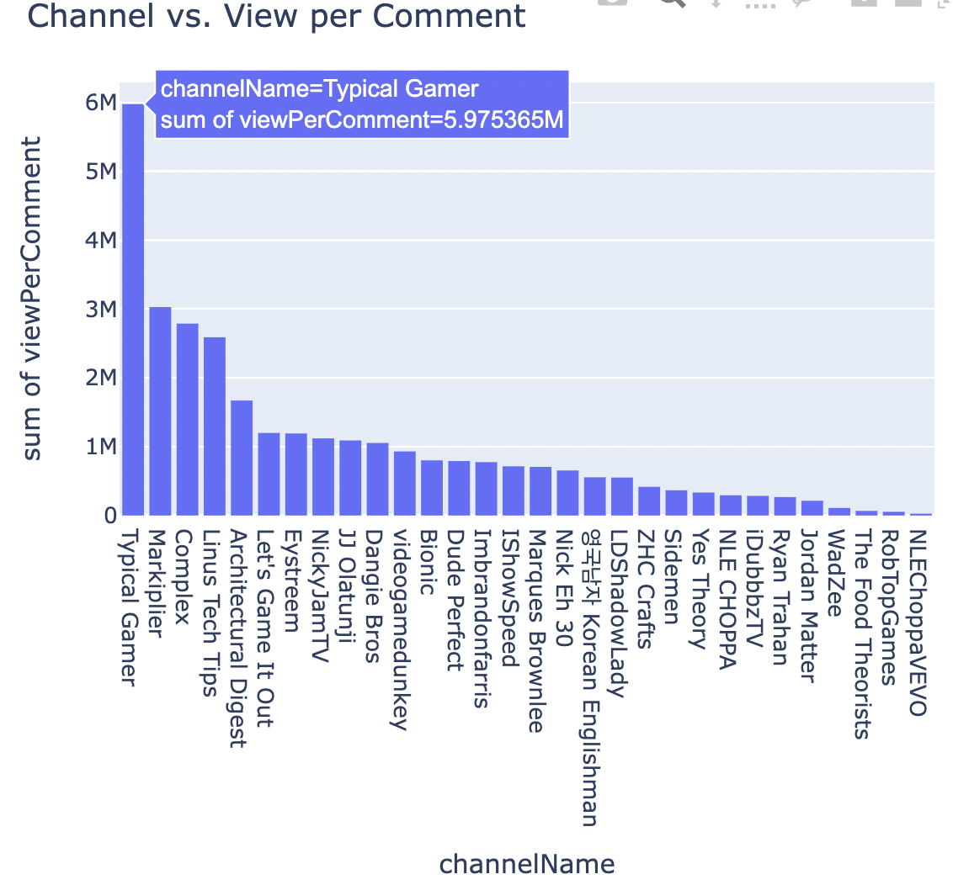
Notes:
View per Comment: how many views on average will have a comment on a video
Markiplier have the highest view count; and Typical Gamer have the highest view per comment

Slide 9
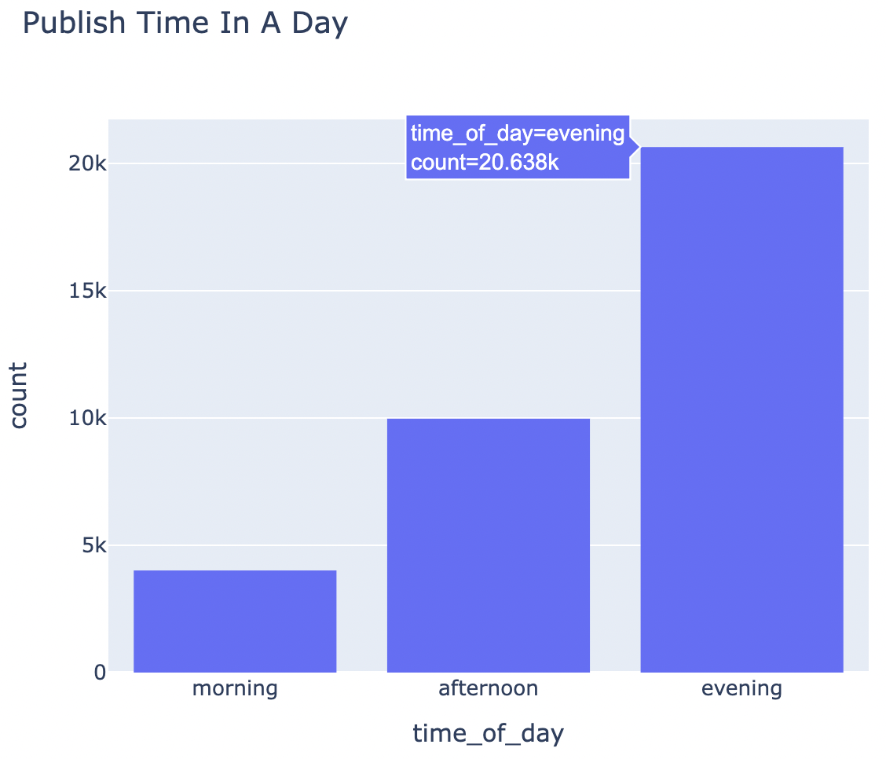
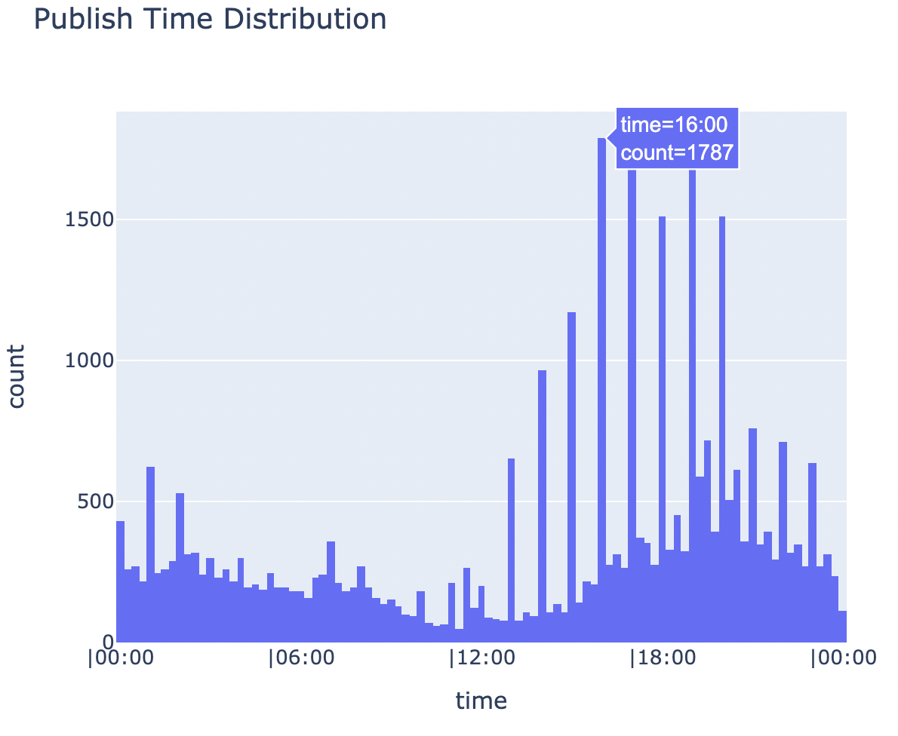
4pm, 5pm and 7pm are the best time to post!
Notes:
Split the posted time into 3 time intervals
Then explore if there is any significant difference between the view count at the videos posted at different times
The results show in the 2 graphs are really close

Slide 10
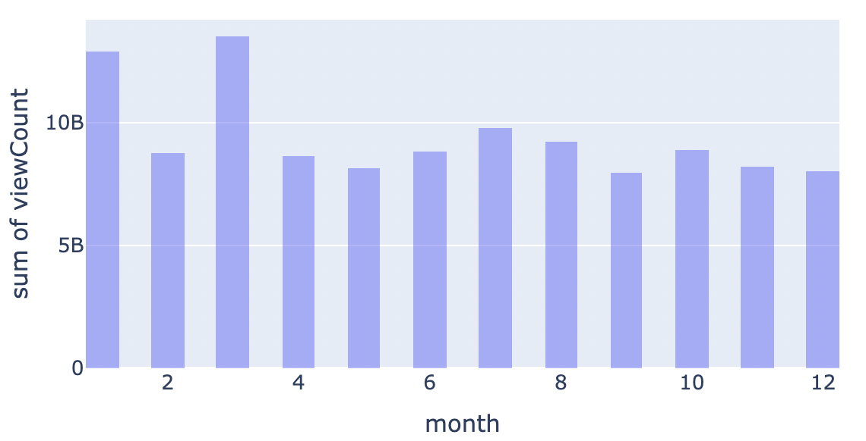
Notes:
We also wondering if there is any relationship between videos’ view count, like count, and comment count and the month they published, but only the bar chart between month and view count shows an apparent pattern that videos posted in January and March will tend to have a relatively higher view count

Slide 11
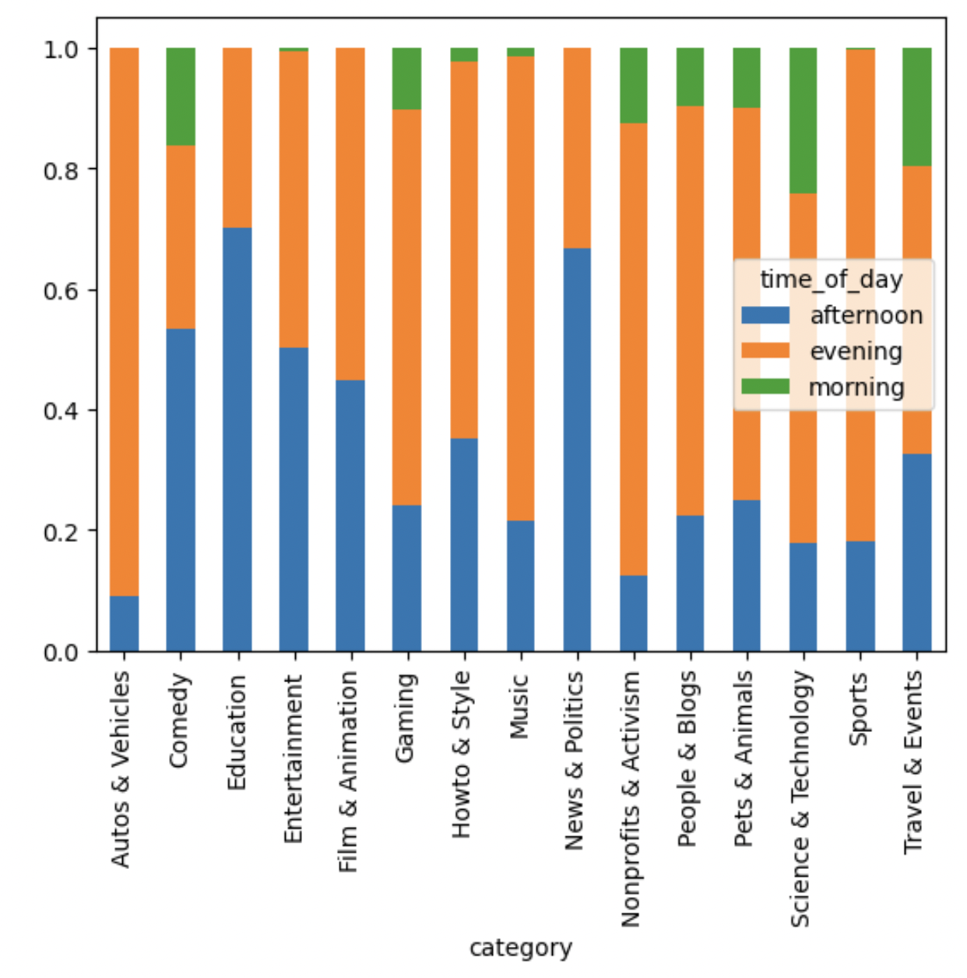
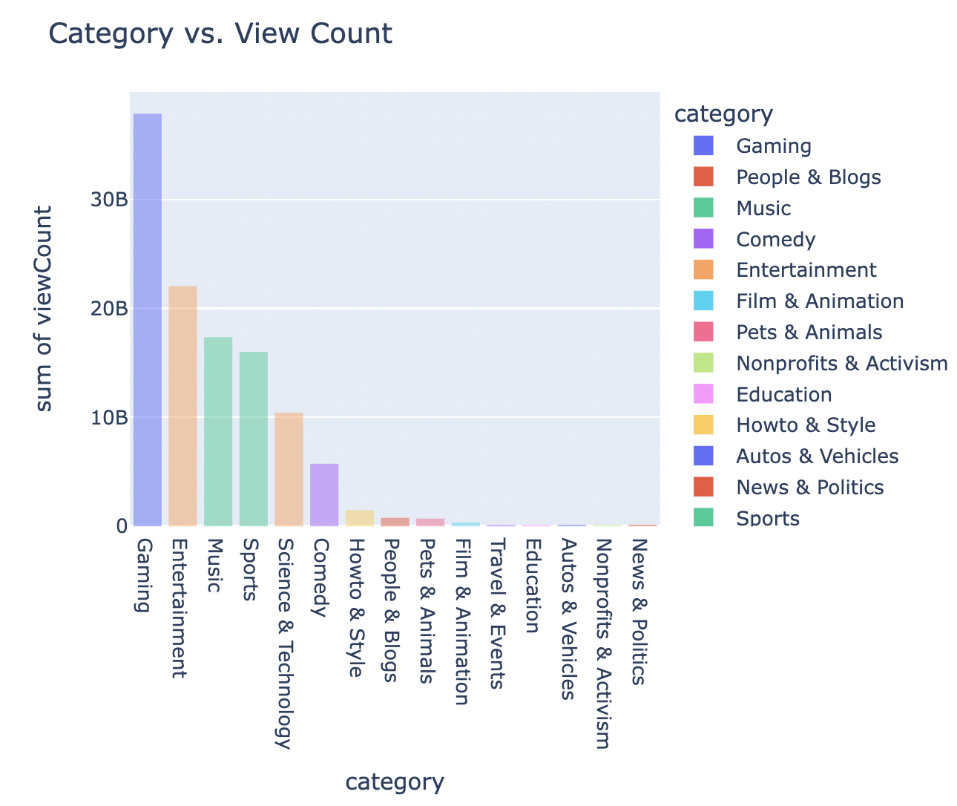
Notes:
Meanwhile, we also attempt to find some useful pattern between category and the posted time, and graph on the left shows that the Gaming videos will tend to have much more view count than the other categories, then the entertainment videos and music videos.
Graph on the right side also shows that the videos posted in the morning will have much lower view than the other 2 times, and for most categories, videos posted at night will have higher view than the videos posted in the afternoon.

Slide 12
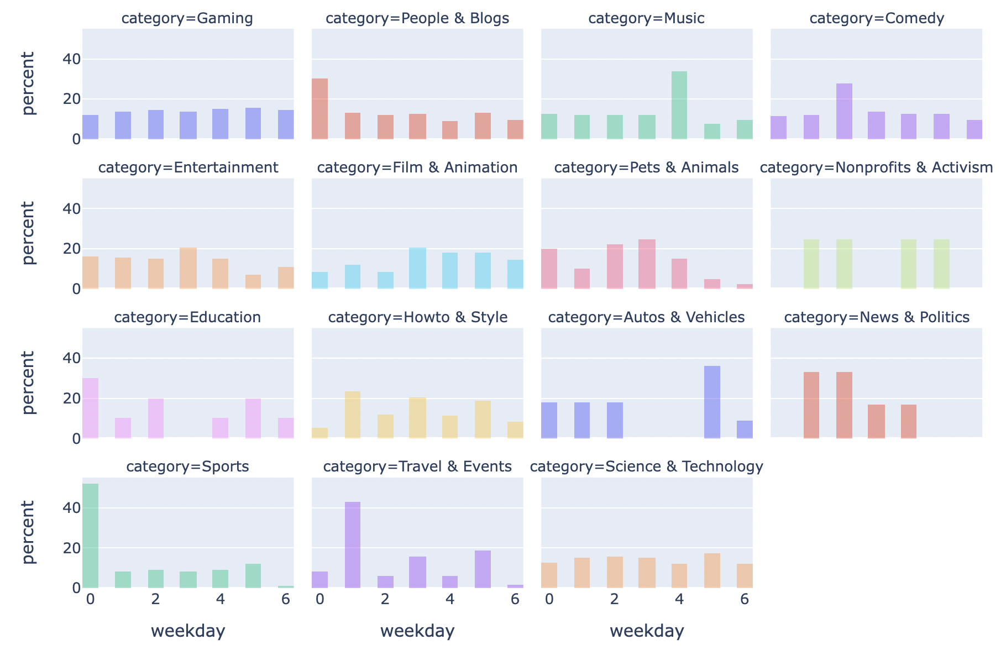
Notes:
For each category, we listed the percentage of videos in each weekday and observed that Sports category tend to publish videos more on Sunday and Auto and vehicle relatives only publish videos on R, W, and F.

Slide 13
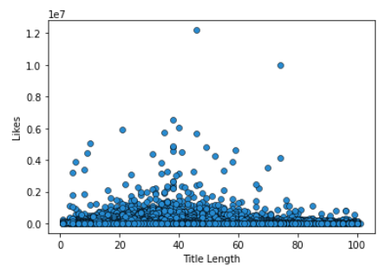
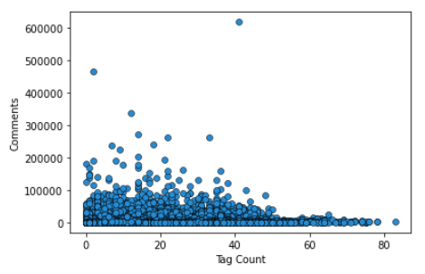
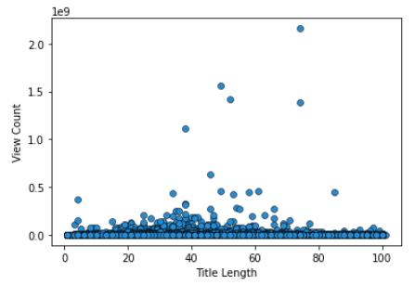
Notes:
We also create some scatter plot between some variables and title length or tag count that we think might show a significant pattern.
Title Length vs. Likes: 20-50 characters
Tag count vs. Comment Count: < 50 tags
Title Length vs. View Count: 30-50 characters

Slide 14
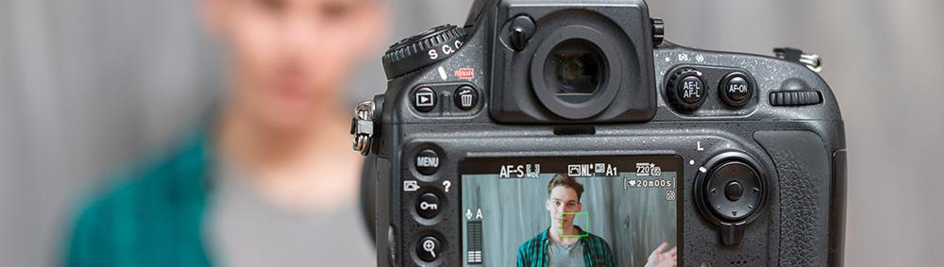
03.
Data Preprocessing
Notes:
We now prepare the data for model implementation. During the preprocessing phase, we encode all categorical variables with numbers so that it can be easily read by the model algorithm.

Slide 15
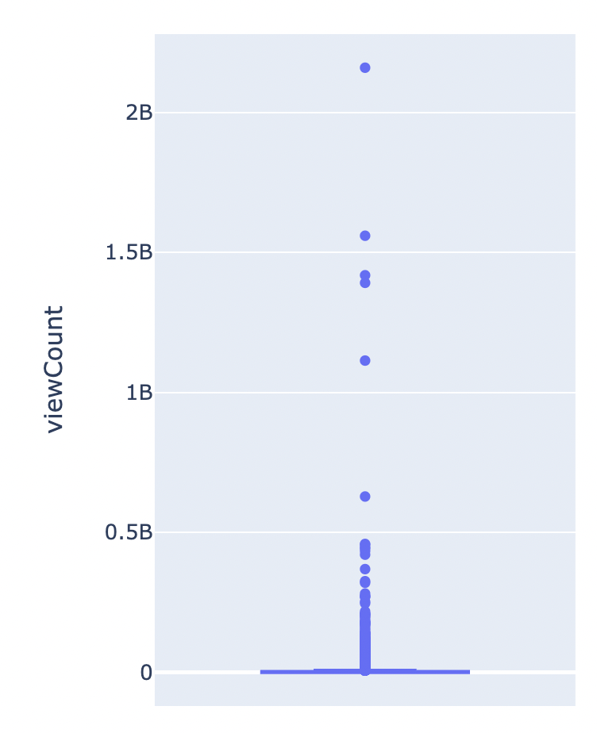
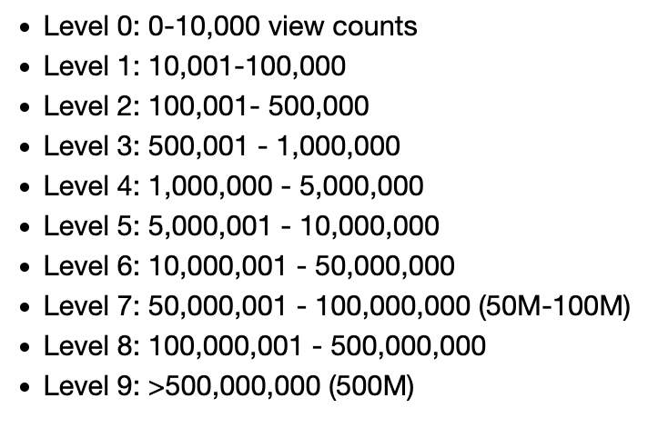
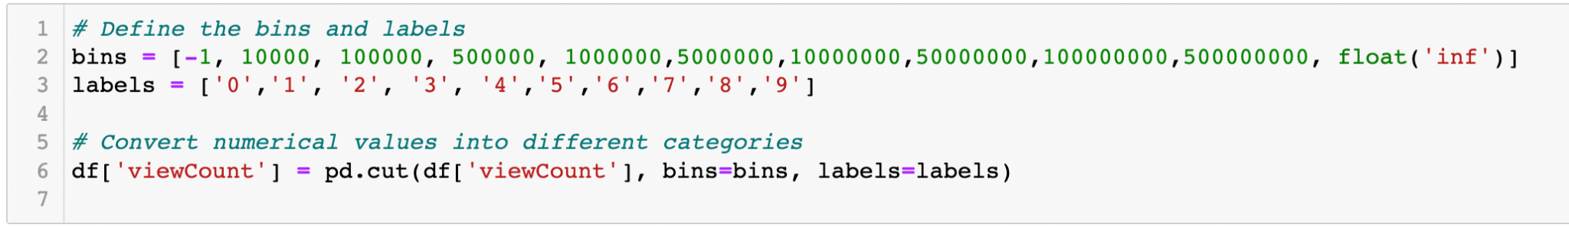
Create a Response Variable

Slide 16
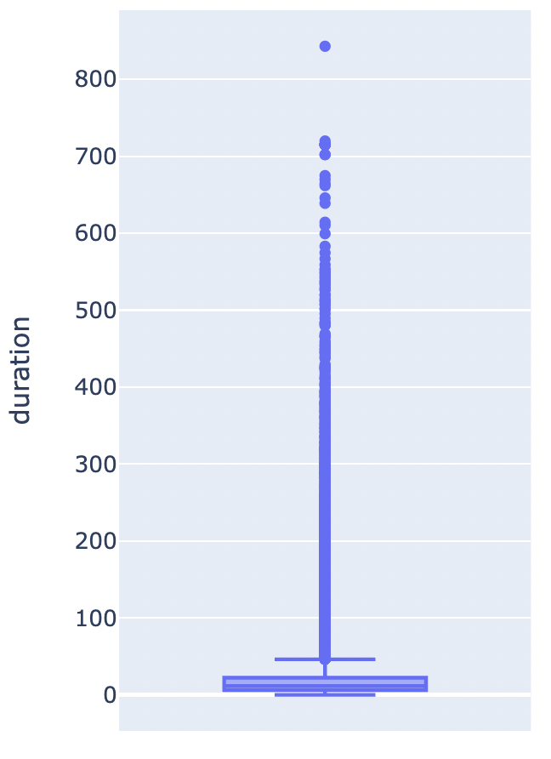
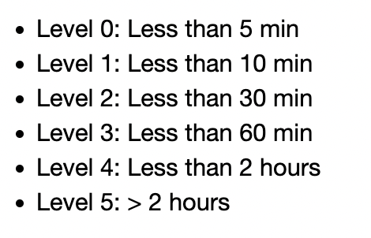
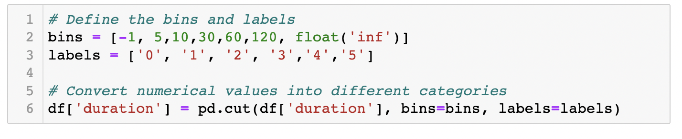
Create Intervals for Duration

Slide 17
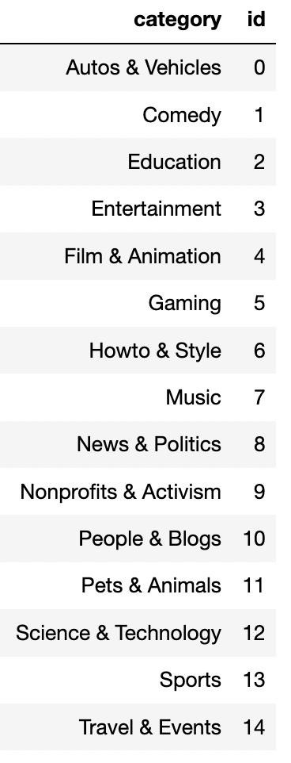
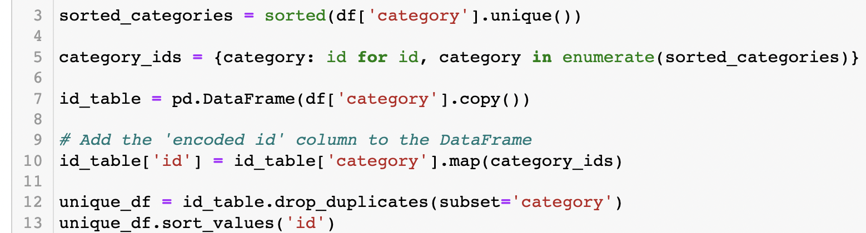
Create Key Table for Category

Slide 18
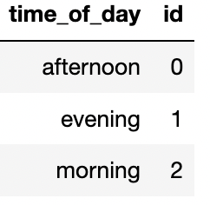
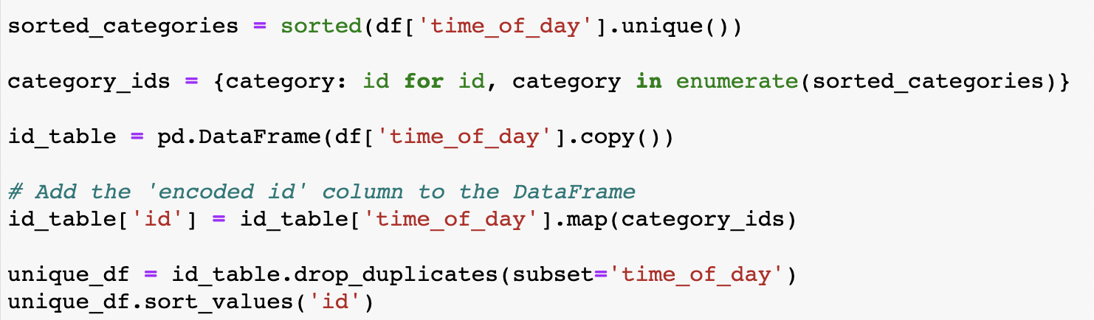
Create Key Table for Time of the Day

Slide 19
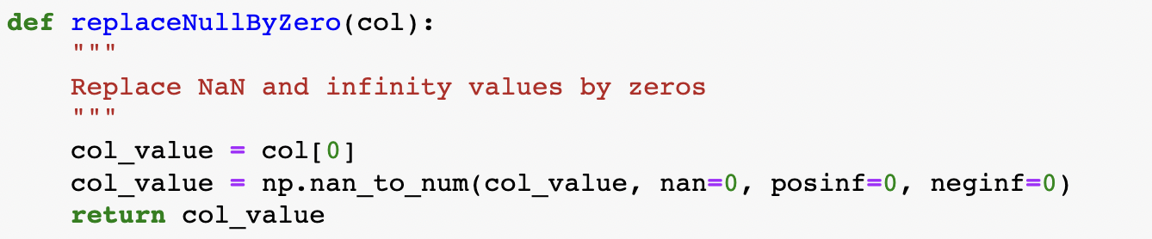
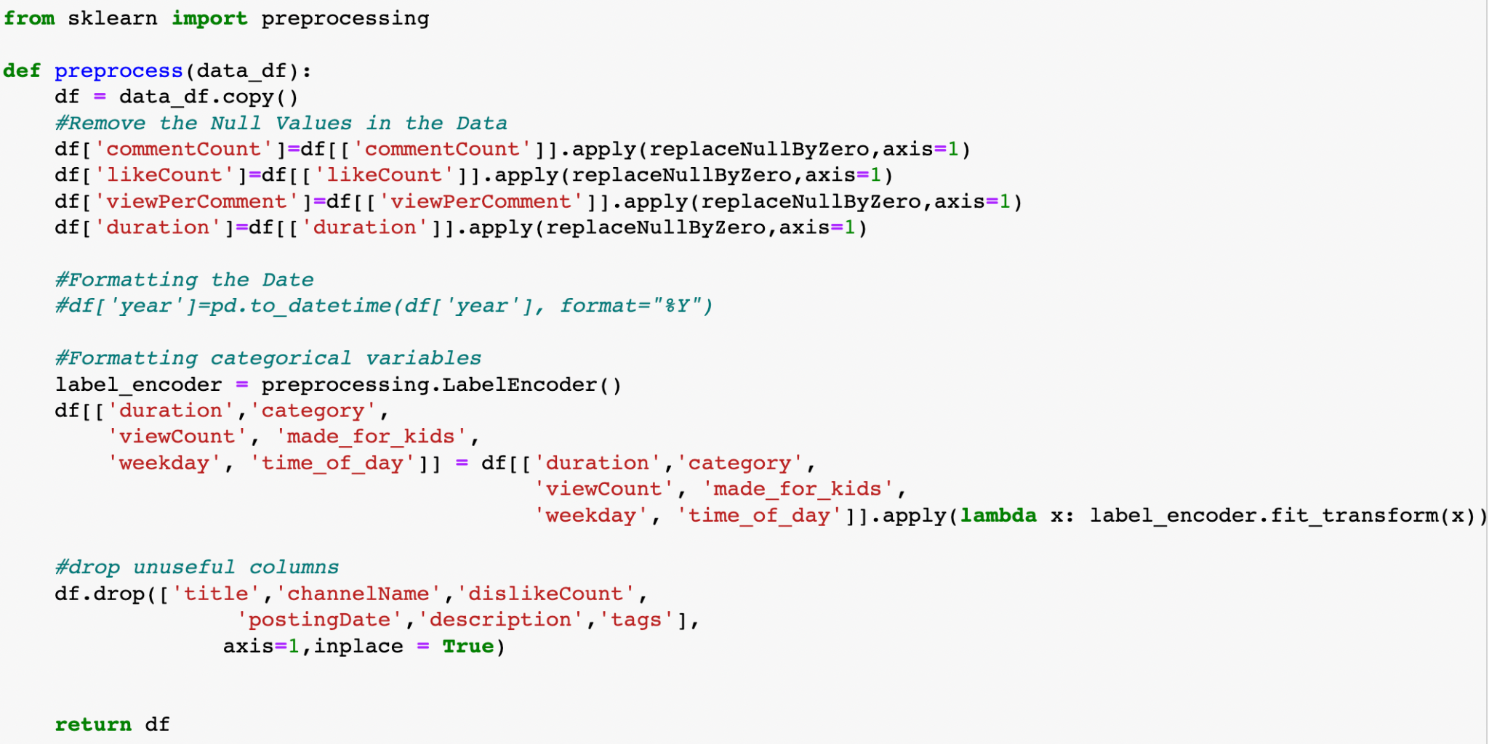
Clean Data: Remove Unimportant Columns, NA imputation etc.
We can remove title, channelName, dislikeCount, postingDate from our dataset.
Notes:
We also remove NAs and replace null and inf generated from the calculation earlier with zero, such as the comment per view variable.

Slide 20
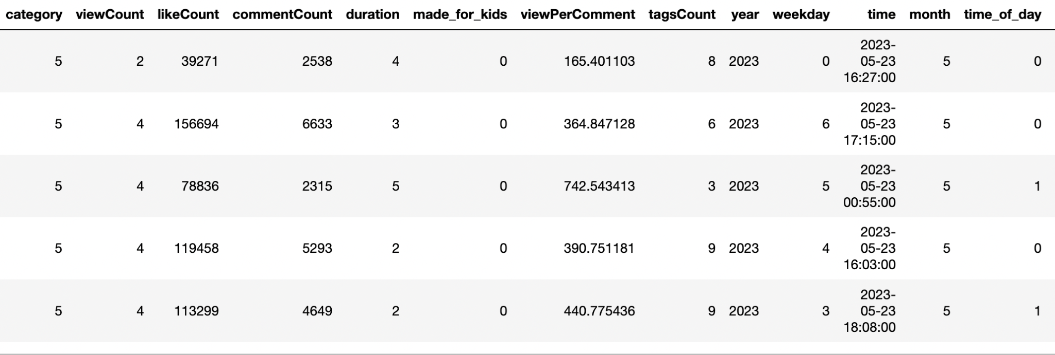
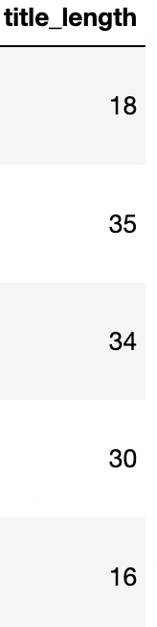
Processed Data
Notes:
Gradient boosting algorithms, such as XGBoost, and Random FOrest often use decision trees as base models, which are not sensitive to the scale of the input features. Therefore, it is not mandatory to normalize the data before training a random forest model.

Slide 21
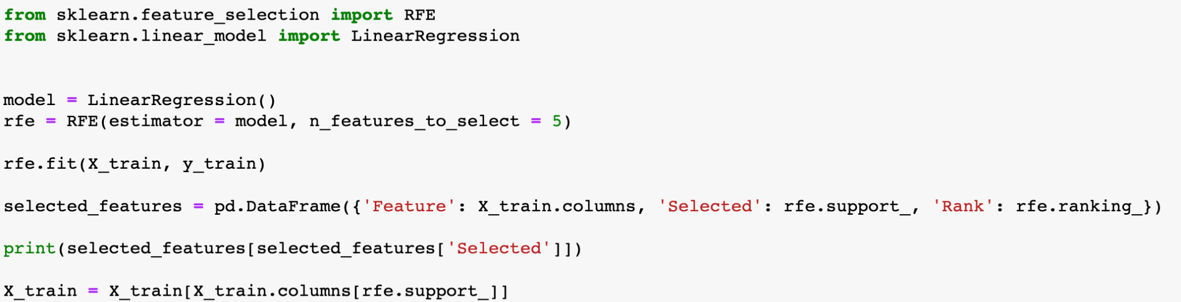
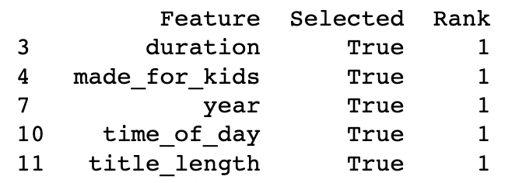
Variable Selection using Recursive Feature Elimination (RFE)
Notes:
In order to ensure the final model is concise and user-friendly, we decided to use recursive feature elimination to reduce the dimension of our dataset. This technique enables us to select the top 5 variables to be utilized in subsequent machine learning models.

Slide 22

04.
Model Building and Training

Slide 23
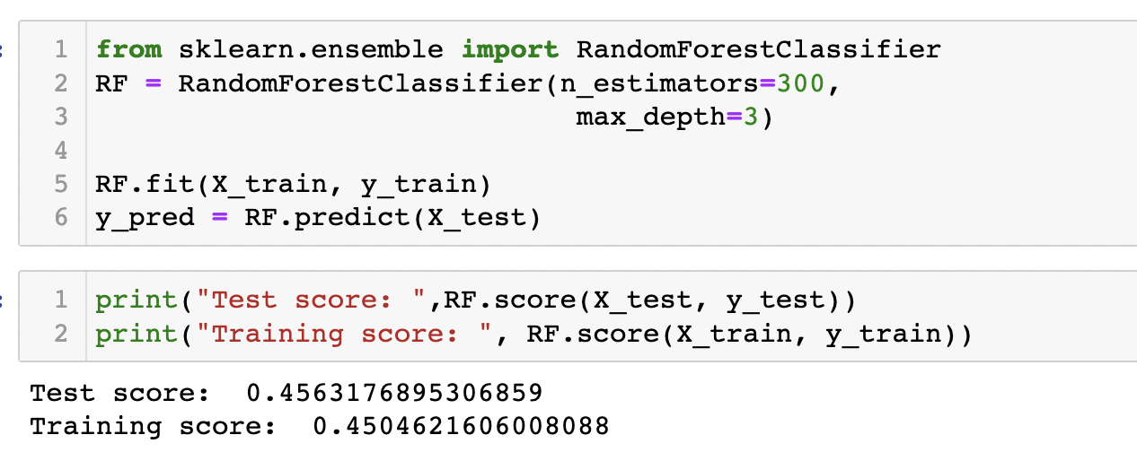
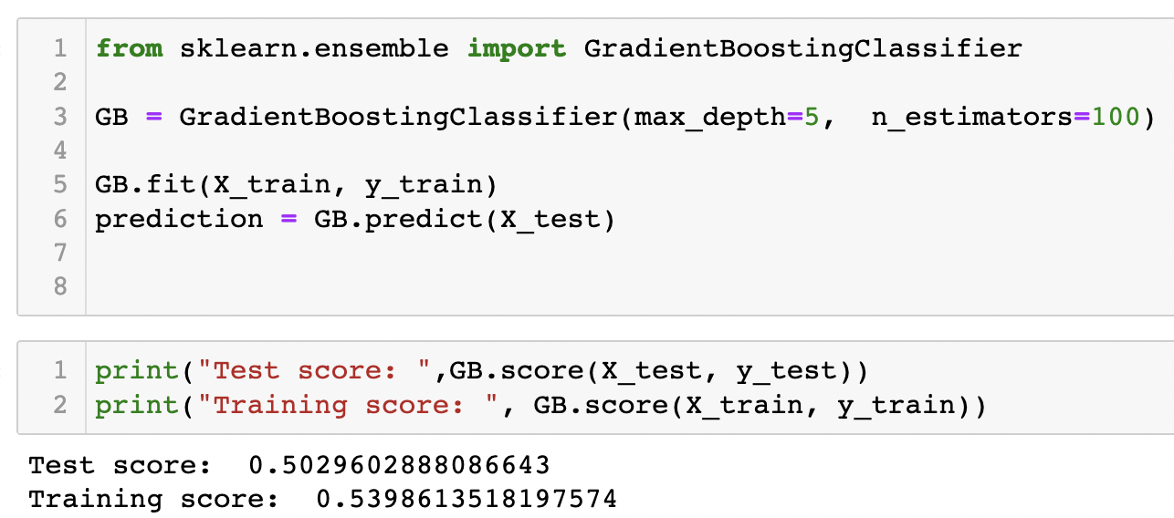
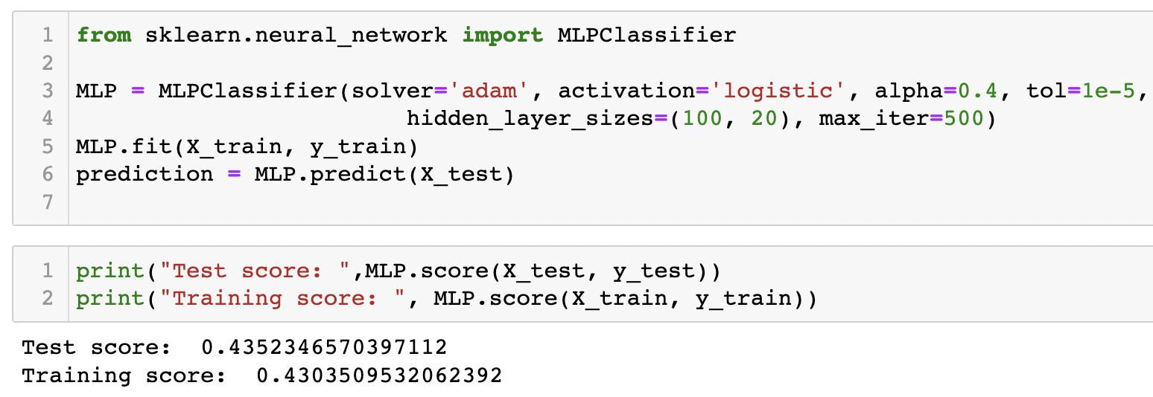
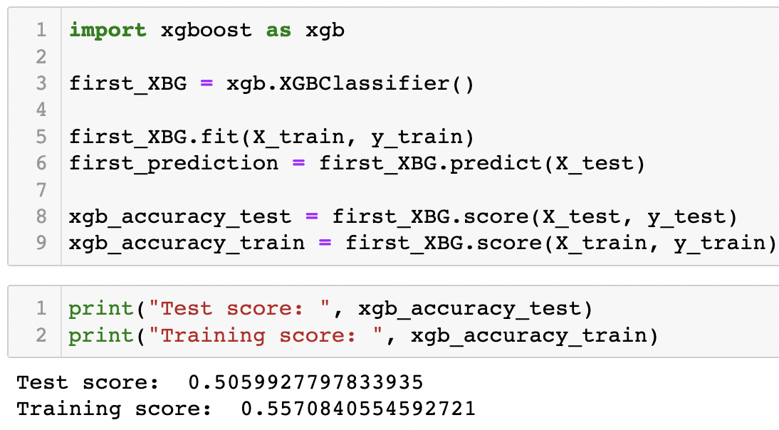
Initial Models
Random Forrest
Gradient Boosting
Neural Network/MLP
XGBoost

Slide 24
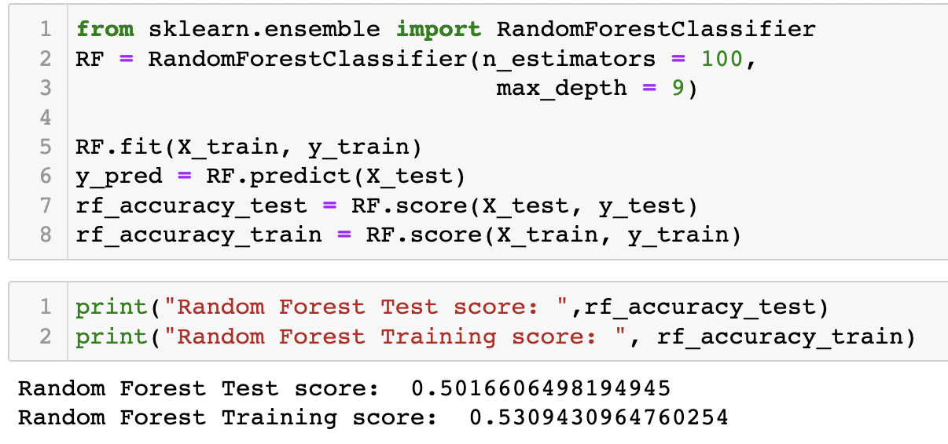
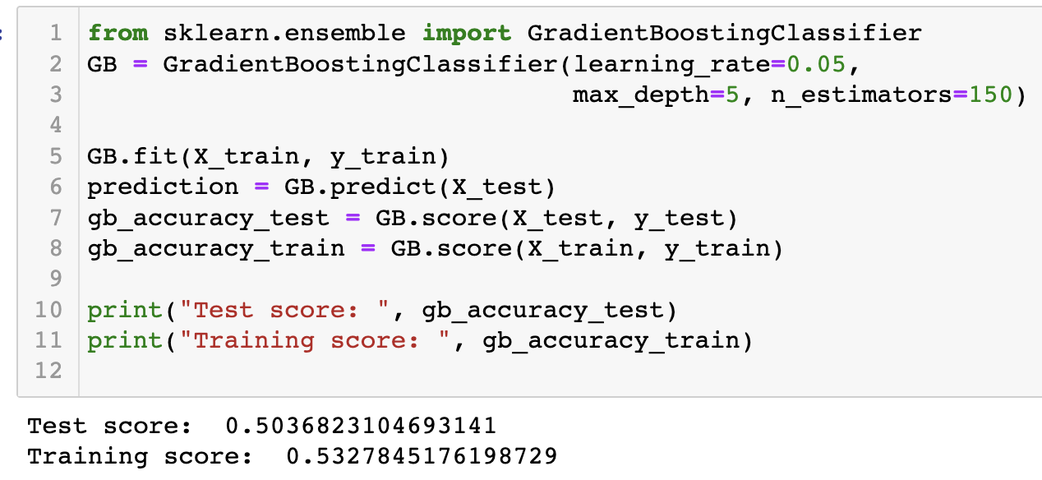
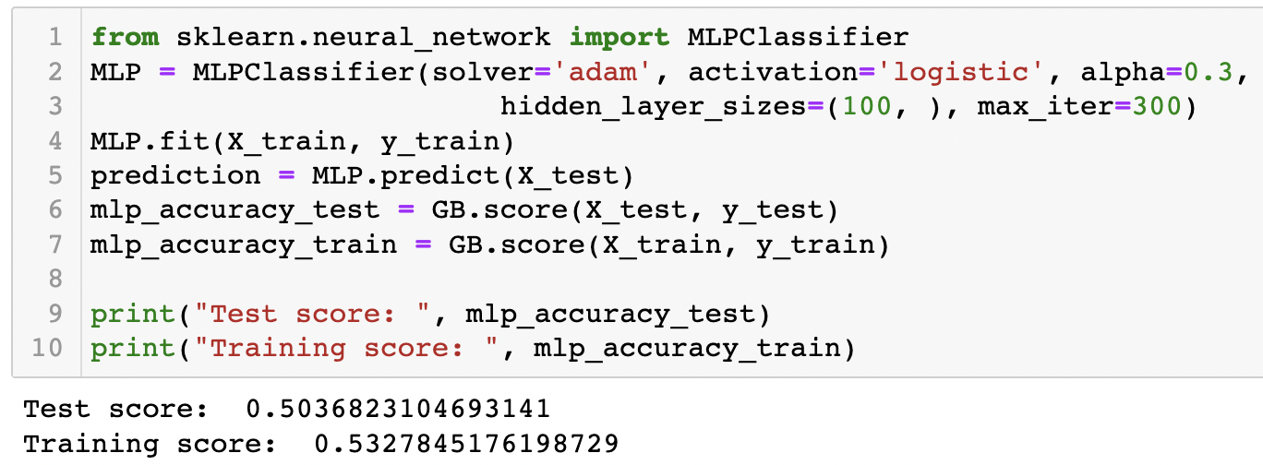
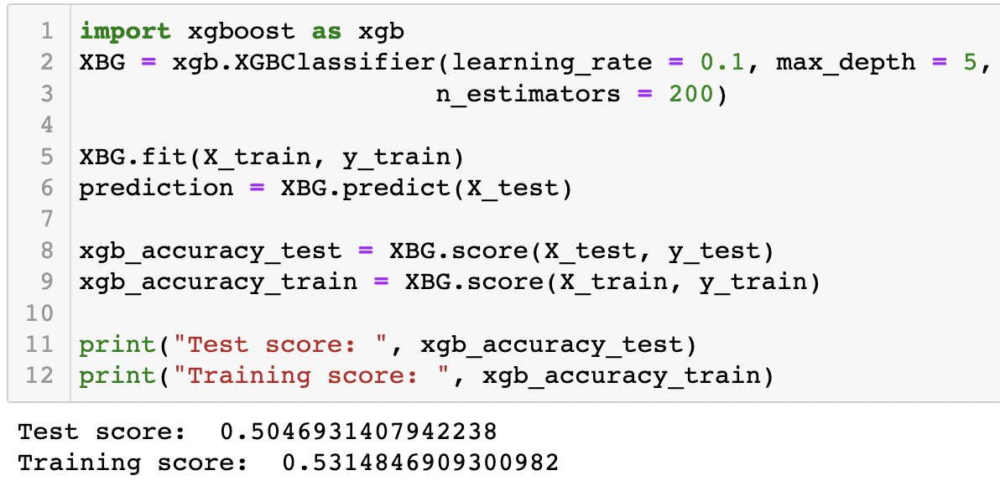
After tuning hyperparameters
Random Forest
Gradient Boosting
XGBoost
Neural Network/MLP

Slide 25
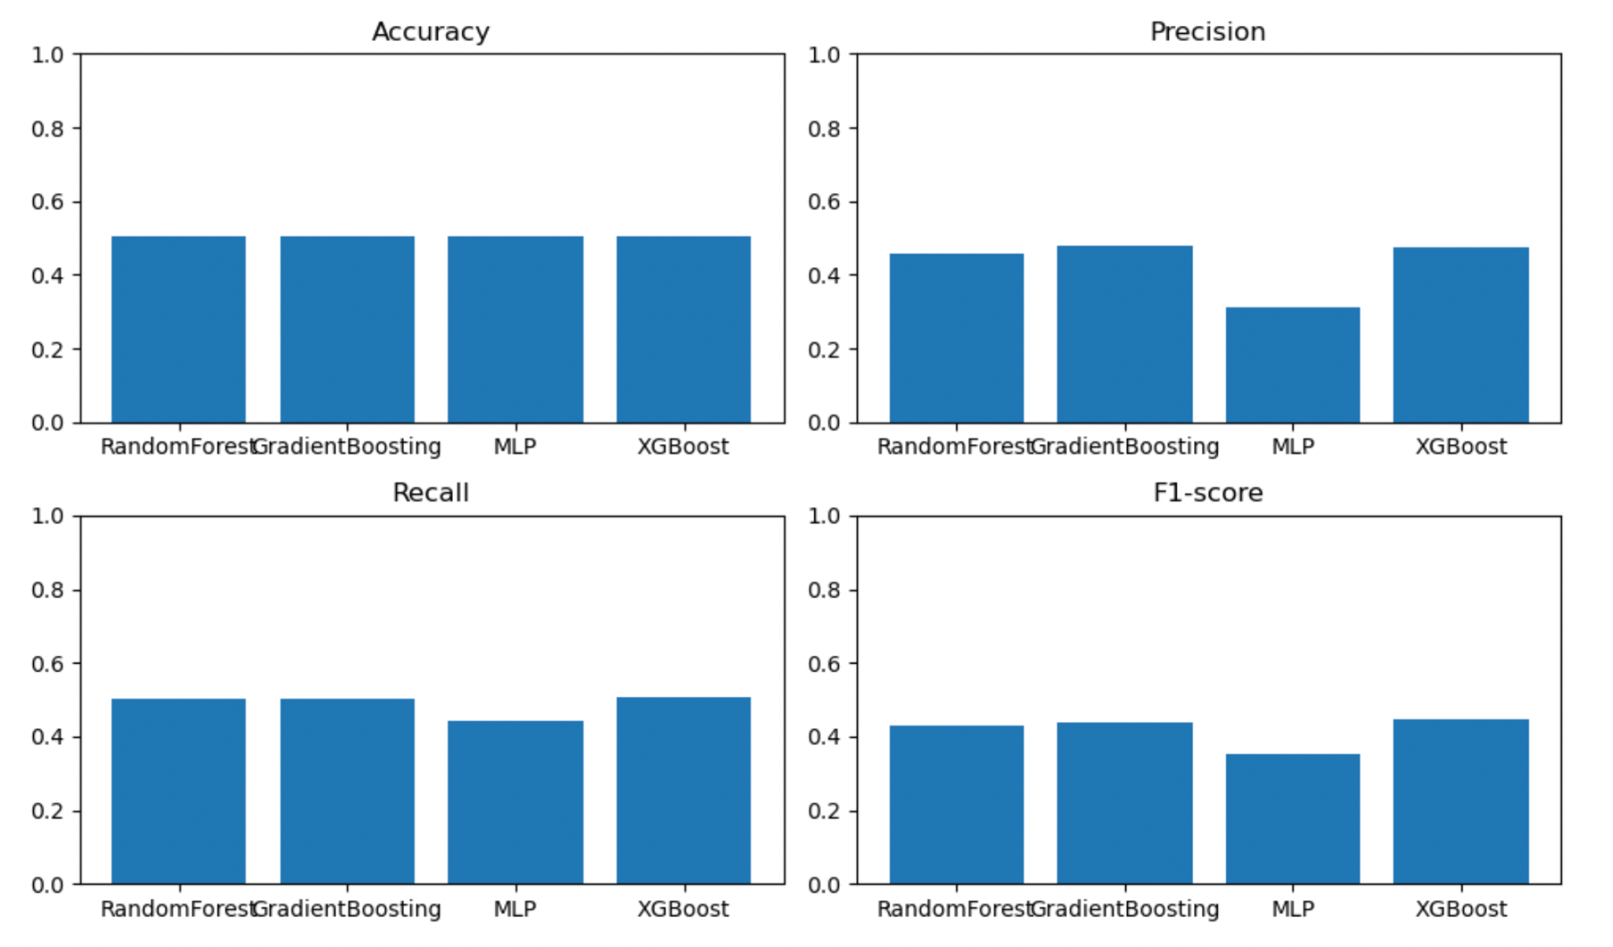
Model Comparison

Slide 26

05.
Website Developing

Slide 27

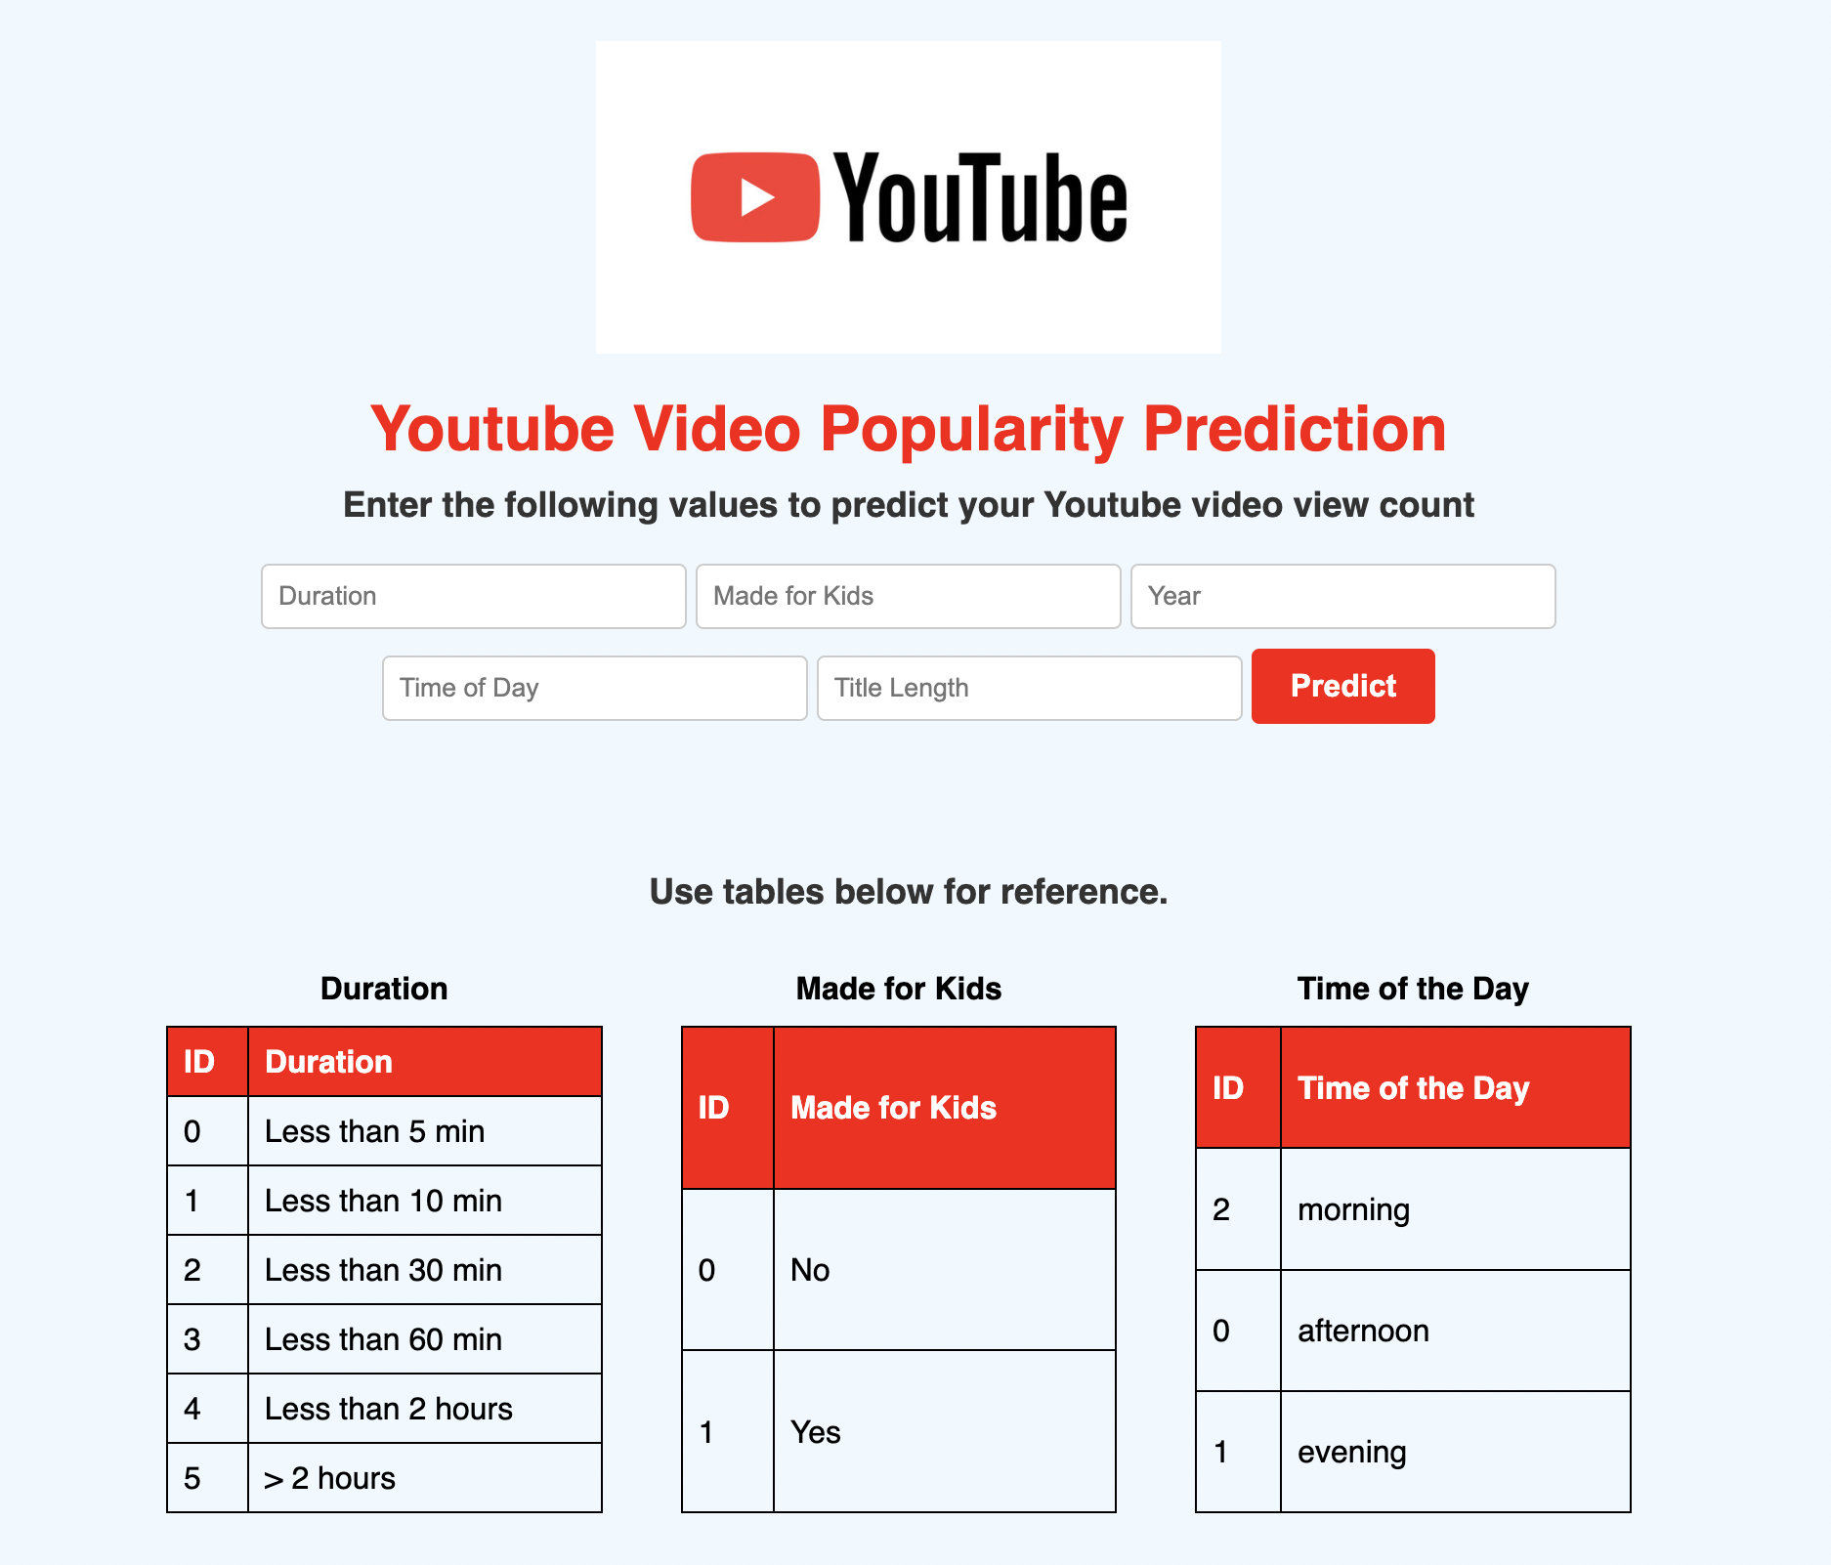
Website Link
Notes:
Deploy our final model using Flask
Flask is a web application framework written in Python.
To integrate Flask with an ML model, I loaded the trained model in my Flask application. Then, I defined routes and views to handle requests, preprocess input data, and pass it to the model for predictions. Finally, I returned the model’s predictions for the users.

Slide 28
Next Steps
Generalize the model to a broader user-base by acquiring additional data and non-trendy YouTube video data and retraining the model accordingly.
Consider employing more advanced techniques such as Natural Language Processing (NLP) to improve the accuracy of the model.
Predict other metrics such as like counts, comment counts.
Enhance the Web Server functionality by incorporating user-friendly features, aiming to improve the overall user experience.

Slide 29
QUESTIONS?

